Slide 1
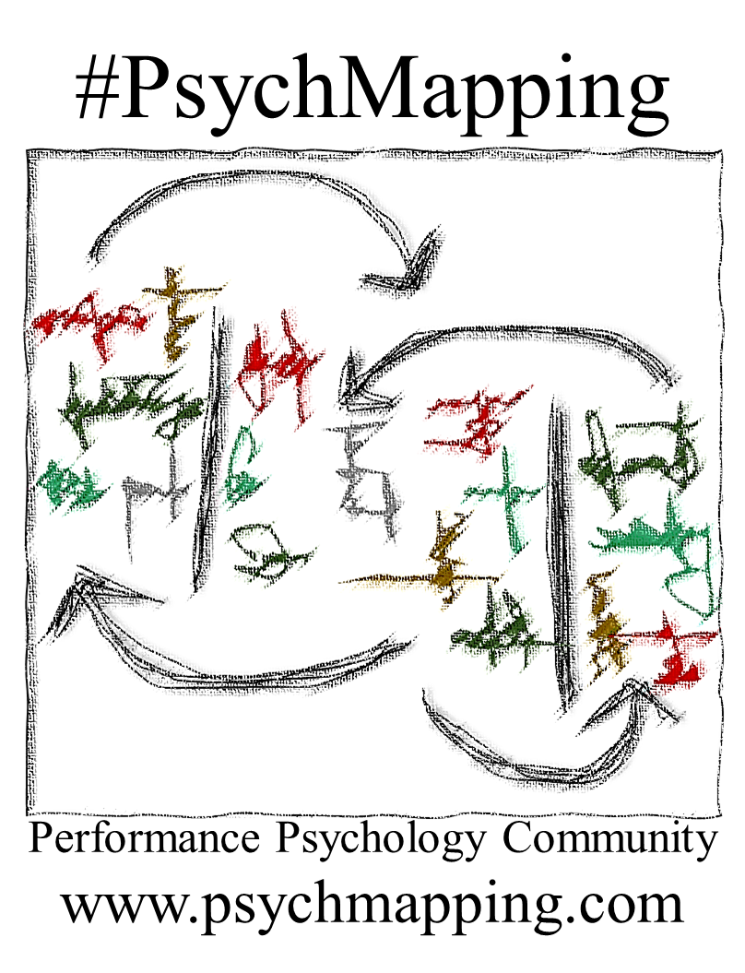
Date: _____/______/20___
Psychologist: _____________________________
Participant: ____________________________________
Type of session: The basic #PsychMapping Exercise
Exercise topic: ______________________________
External variables
Personal descriptors
(traits & states)
Self-regulation
(strategies and skills)
Very problematic – rather problematic – equally helpful as problematic – rather helpful – definitely helpful
Important – Regular

