Slide 1
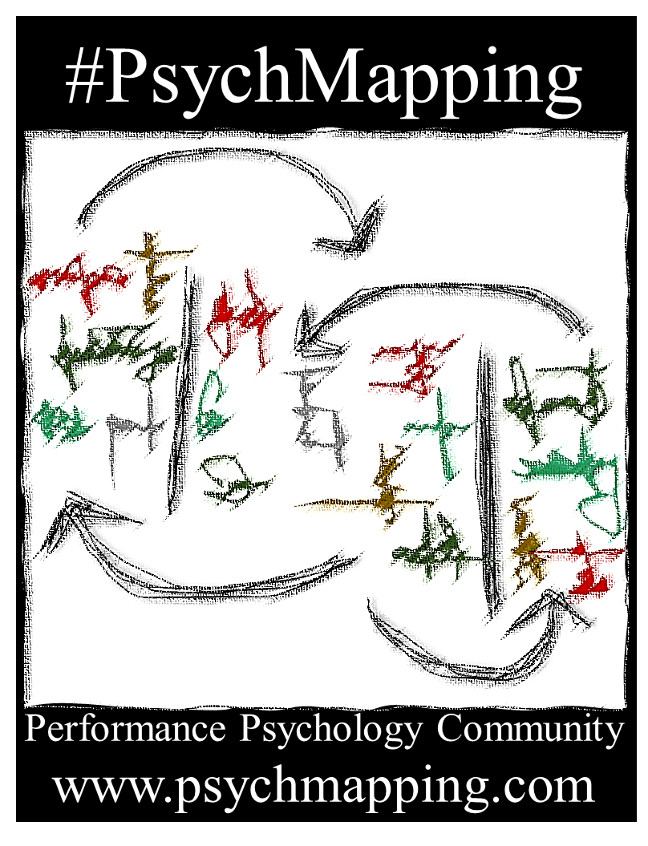
Revised version
Sport & Exercise Edition
Follow us on Twitter @PsychMapping
Find out more about us:
www.psychmapping.com

Slide 2
What are we going to do?
01
Opening section
We define the aims of the exercise
We look at the materials we're going to use
We decide what the topic of the exercise will be
We will explore different external influences, personal traits and self-regulation
While answering, we will create a map with your answers
Once you've responded, we rate each entry on the map
We summarise the map before you take it home with you

Slide 3
The exercise aims and guidelines
02
Opening section
Aim – The goal of the exercise is to visually represent important aspects related to a topic that can be as broad as 'performance' and as narrow as 'sports anxiety'.
Asking questions – Practitioners demand a certain number of answers, for example, three, to either stimulate further thought or encourage selection of more relevant answers.
Making entries on the map – To make an entry on the map, participants’ longer answers must be converted into a short sentence or words that represent the long answer.
Rating concepts on the map – Participants rate the extent to which an entry contributes positively or negatively to the topic being analysed.

Slide 4
Some theoretical key points
03
Opening section
Psychological reality – The subjective experience of aspects that define and influence us and our performance, our commitment and our enjoyment.
External variables – Where we are, what we have, who we are with and what we do. Physical, organisational, social and task-related aspects around us.
Personal descriptors – Biological, physiological and above all psychological aspects that describe us in general and in a specific context and in certain moments.
Self-regulation – Our learned skills and strategies with which we control our personal descriptors and adapt them to internal and external demands.

Slide 5
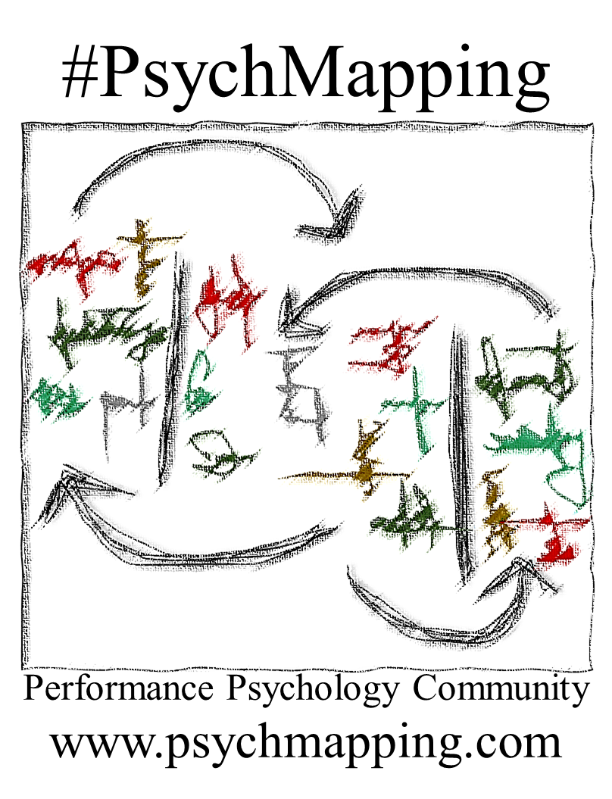
04
Opening section
Examples
of external variables, personal descriptors and self-regulation
External variables
Personal descriptors
Self-regulation
Work
Personality
Rationalisation skills
Living conditions
Injuries and health
Leadership skills
Training routines
Mental health/ illbeing
Biometrics
Emotions and feelings
Persuasion skills
Goal-setting skills
Parents and siblings
Recent events
Thoughts and ideas
Controlled imagery
Work facilities
Gender
Communication skills
Friends and community
Effort and fatigue
Teaching skills
Life circumstances
Motivation/ goals
Empathy skills
Income
Attitudes and beliefs
Motivation skills
Physical activity options
Occupations
Fitness
Concentration
Emotion control
Local culture and politics
Life goals
Genetics
Age
Self-regulated learning
Food and drinks
Strength and speed
Goal-directed self-talk
Partners and friends
Spontaneous self-talk
Self-skills
Follow us on Twitter @PsychMapping
Find out more about us:
www.psychmapping.com

Slide 6



05
Opening section
1) Enter the date and names on the map
2) What topics would you like to explore today?
3) What do you expect from this #PsychMapping session?
Follow us on Twitter @PsychMapping
Find out more about us:
www.psychmapping.com

Slide 7


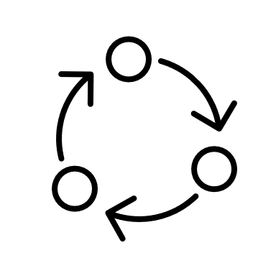






07
Exploring external factors
Identify key people and aspects of their behaviour that you think are most relevant to exploring today's topic.
You could mention family, partners, children, friends, teammates, training partners, coaches, mentors, managers, agents, idols, … even people you have lost or no longer see.
Follow us on Twitter @PsychMapping
Find out more about us:
www.psychmapping.com

Slide 8












08
Exploring external factors
Identify key societal and organisation influences that you think are most relevant to exploring today's topic.
You could mention culture, politics, societies, clubs, federations, professional associations, governments, Olympic committees, academies, schools, institutes and universities, finances, health services, sport culture, religion, media, personal contracts, sponsorships, grants,…
Follow us on Twitter @PsychMapping
Find out more about us:
www.psychmapping.com

Slide 9

















06
Exploring external factors
Identify key physical and environmental conditions and objects that you think are most relevant to exploring today's topic.
You could mention weather, facilities, distance, transport, location, technology, screens, food, nutritional supplements, substances, clothing, noise, entertainment options, heat and cold, illumination, urbanism and nature....
Follow us on Twitter @PsychMapping
Find out more about us:
www.psychmapping.com

Slide 10

09
Exploring external factors
Identify key aspects of your training and competitions and important events in them that you think are most relevant to exploring today's topic.
My sport is special because…
Training is typically…
Some exercises are…
Competitions are…
Something important that happened is…
Follow us on Twitter @PsychMapping
Find out more about us:
www.psychmapping.com

Slide 11





















10
Exploring external factors
Identify other activities, commitments or life events that you think are most relevant to exploring today's topic.
You could mention participating in social media, watching online sports content, school or university, family activities, work commitments, travel, religious or cultural activities, gaming, meeting friends, weddings, funerals, other people’s ilnesses, moving house ...
Follow us on Twitter @PsychMapping
Find out more about us:
www.psychmapping.com

Slide 12

11
Exploring external factors
Look at the summary map and think about any other external factors that you think are relevant to exploring today's topic.
What else?
Mention any other external factors that you think we need know to understand your case.
Follow us on Twitter @PsychMapping
Find out more about us:
www.psychmapping.com

Slide 13









12
Personal descriptors
Identify key aspects that describe you physically (your body) and that you think are most relevant to exploring today's topic.
You could mention health, injuries, recovery, pain, fatigue, appearance, height, weight, fitness, strength, speed, agility, flexibility, age, gender…
Follow us on Twitter @PsychMapping
Find out more about us:
www.psychmapping.com

Slide 14

13
Personal descriptors
Identify key aspects about yourself (who you are) that you think are most relevant to exploring today's topic.
You could mention personality, self-esteem, beliefs, preferences, religious beliefs, habits, skills, experiences, motivations, goals, attitudes, plans, values, social roles, affiliations to groups or societies, memories, gender and sexuality…
Follow us on Twitter @PsychMapping
Find out more about us:
www.psychmapping.com

Slide 15
















14
Personal descriptors
Identify ways in which you react prior to, during or after better or worse moments that you think are most relevant to exploring today's topic.
You could mention thoughts, emotions, feelings, confidence, physical sensations, attitudes, interpretations, self-talk, social experiences, decisions, behavioural intentions…
Follow us on Twitter @PsychMapping
Find out more about us:
www.psychmapping.com

Slide 16

15
Personal descriptors
Identify aspects that differentiate you from others and that you think are most relevant to exploring today's topic.
Compared to other people, I am more/less…
One thing that makes me special is…
My case is different because I …
Follow us on Twitter @PsychMapping
Find out more about us:
www.psychmapping.com

Slide 17





16
Personal descriptors
Identify important changes you have noticed in yourself that you think are relevant to exploring today's topic.
In the past months I have been…
Over the past years I have become…
Lately I am…
I have changed insofar as I am now…
Follow us on Twitter @PsychMapping
Find out more about us:
www.psychmapping.com

Slide 18

















17
Personal descriptors
Identify which aspects of your performance and behaviour are most relevant to exploring today’s topic?
You could mention successes and failures, social interactions, verbal and non-verbal expressions, conflicts, leadership,
emotion expression, specific actions like jumping, running, passing a ball, appearance, being present/absent…​
Follow us on Twitter @PsychMapping
Find out more about us:
www.psychmapping.com

Slide 19

18
Personal descriptors
Look at the summary map and think about any other aspects about yourself that you think are relevant to exploring today's topic.
Anything
else?
Mention any other personal descriptors that you think we need know to understand your case.
Follow us on Twitter @PsychMapping
Find out more about us:
www.psychmapping.com

Slide 20






Self
regulation
19
Self
Regulation
Identify strong mental skills that you think are most relevant to exploring today's topic.
I am good at …
Most of the time I can …
I manage to …
I can avoid …
You could mention your ability to control aspects in your daily life, your emotions, your goals and motivation, your thoughts, beliefs and attitudes, your self-image, your behaviour, your social interactions…
Follow us on Twitter @PsychMapping
Find out more about us:
www.psychmapping.com

Slide 21






20
Self
Regulation
Identify mental skills you need to improve that you think are most relevant to exploring today's topic.
I feel it’s hard to…
Most of the time, I find it difficult to…
I don’t try to…
A weakness I feel I have is…
You could mention difficulties to control aspects in your daily life, your emotions, your goals and motivation, your thoughts, beliefs and attitudes, your self-image, your behaviour, your social interactions…
Follow us on Twitter @PsychMapping
Find out more about us:
www.psychmapping.com

Slide 22



21
Self
Regulation
Identify the coping strategies you use in difficult situations related to today’s topic.
You might mention changing aspects about yourself, changing the way you interpret events, accepting difficulties, avoiding difficulties, distracting yourself, compensating with pleasurable activities, listening to music, talking to others, making excuses, blaming others, playing the victim...
Follow us on Twitter @PsychMapping
Find out more about us:
www.psychmapping.com

Slide 23



22
Finishing the map
1) Revise the map. Are there any key concepts that we have not discussed, or which are not noted down and that you think are most relevant to exploring today's topic.
2) Now please rate each of the entries on the summary map with regards to today's topic.
Very helpful
Rather helpful than problematic
Equally helpful as problematic
Rather problematic than helpful
Very problematic
3) Some follow-up activities
Underline especially relevant entries on the map.
Identify relationships between entries in different columns.
Identify aspects that you would like to see changed and consider how you can change them.
Look at the map routinely for a few weeks and make changes based on your daily experiences.
Follow us on Twitter @PsychMapping
Find out more about us:
www.psychmapping.com

