Slide 1
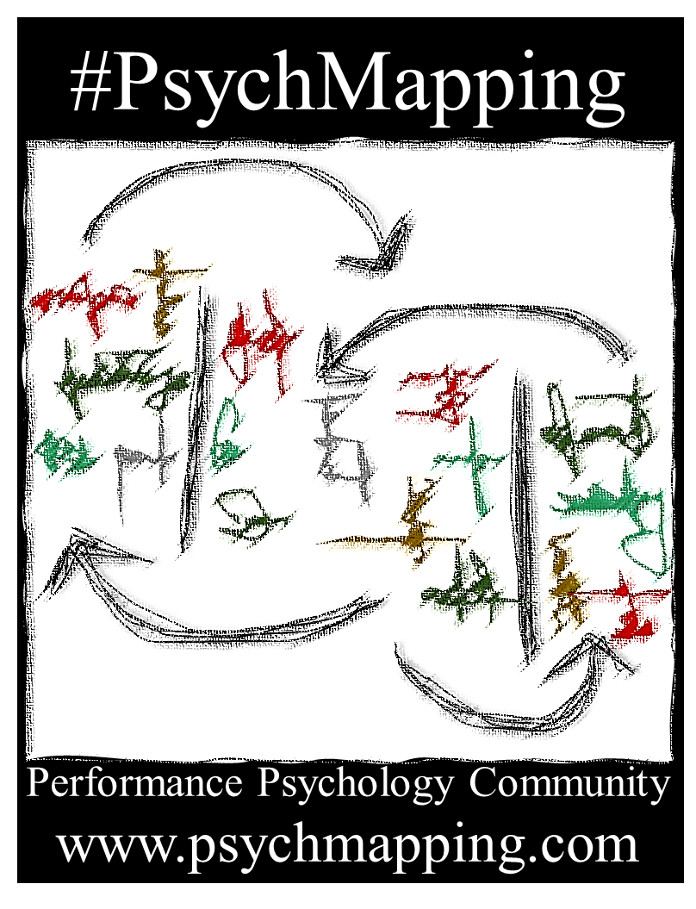
Question cards - Guided edition
(Foundations Course Version)
- 2022 -
Based on:
Latinjak, A. T., Morelló-Tomás, E., & Figal-Gómez, L. (2021). #SportPsychMapping: An Exploratory Interview Framework for Sport and Exercise Psychology. The Sport Psychologist, https://doi.org/10.1123/tsp.2020-0120
Follow us on Twitter @PsychMapping
Find out more about us:
www.psychmapping2.com

Slide 2
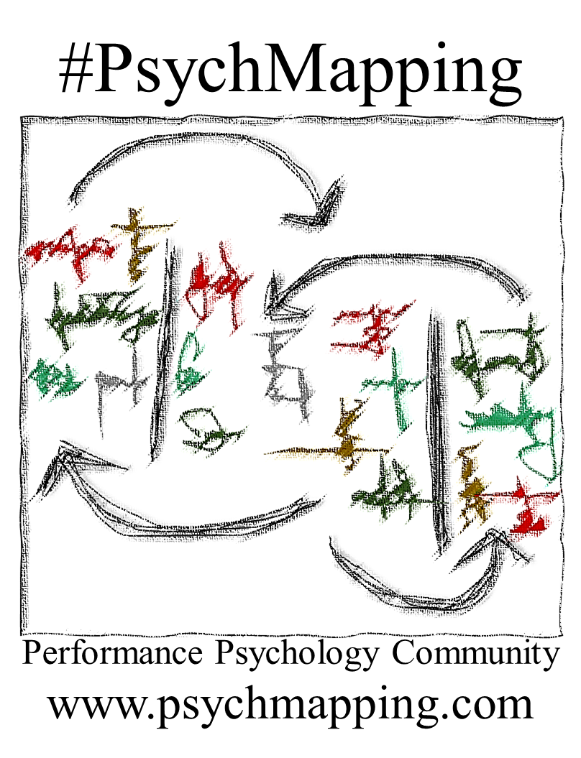
01
Opening section
What are we going to do?
We define the aims of the exercise
We look at the materials we're going to use
We decide where to start, with external or internal influences
We will explore different external influences, personal traits and skills
While answering, we will create a map with your answers
Once you've responded, we rate each entry on the map
We summarise the map before you take it home with you
Follow us on Twitter @PsychMapping
Find out more about us:
www.psychmapping2.com

Slide 3
02
Opening section
Some theoretical key points
Psychological reality – The subjective experience of aspects that define and influence us and our performance, our commitment and our enjoyment.
External variables – Where we are, what we have, who we are with and what we do. Physical, organisational, social and task-related aspects around us.
Personal descriptors – Biological, physiological and above all psychological aspects that describe us in general and in a specific context and in certain moments.
Psychological skills – Our learned skills and strategies with which we control our personal descriptors and adapt them to internal and external demands.
Follow us on Twitter @PsychMapping
Find out more about us:
www.psychmapping2.com

Slide 4
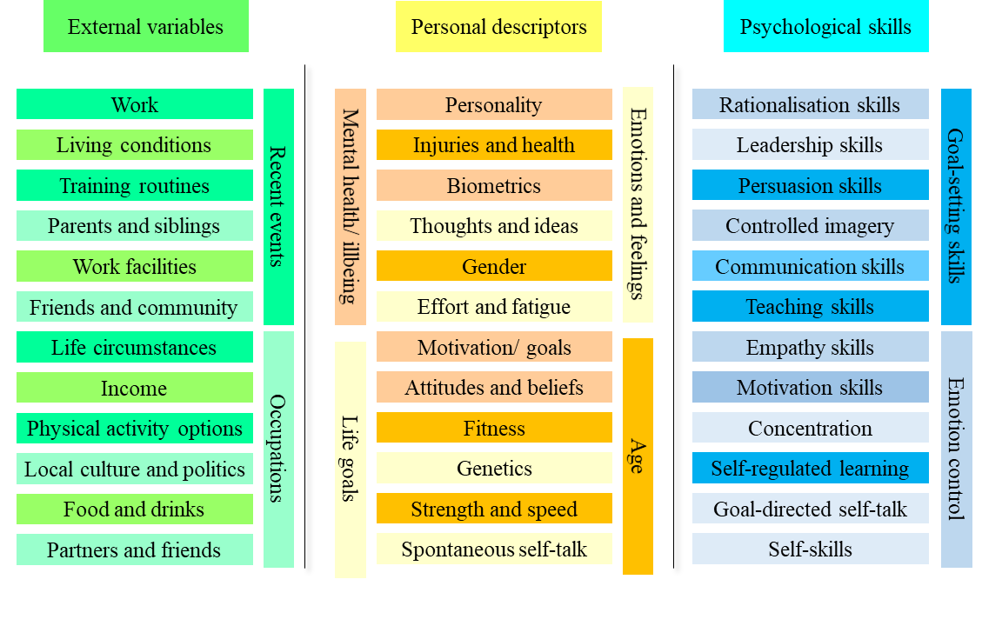
03
Opening section
Examples
of external variables, personal descriptors and psychological skills
Follow us on Twitter @PsychMapping
Find out more about us:
www.psychmapping2.com

Slide 5



04
Opening section
1) Why have you opted for performance psychology services/ why have you asked for a consultation session?
2) What topics would you like to address in the following sessions or today?
3) What do you expect from this performance psychology service?
Follow us on Twitter @PsychMapping
Find out more about us:
www.psychmapping2.com

Slide 6

















05
Exploring external factors
Could you mention 3 things about the physical and environmental conditions in your performance context that you believe to be the most relevant (in your case)?
You could mention weather, facilities, distance, transport, location, technology, food, clothing, noise, entertainment options, heat and cold, illumination, green areas and nature....
Follow us on Twitter @PsychMapping
Find out more about us:
www.psychmapping2.com

Slide 7












06
Exploring external factors
Could you mention 3 things about the organisations that make up your performance context that you believe to be the most relevant (in your case)?
You could mention clubs, federations, professional associations, governments, Olympic committees, academies, schools and universities, finances, health services, sport culture, religion, media, country…
Follow us on Twitter @PsychMapping
Find out more about us:
www.psychmapping2.com

Slide 8


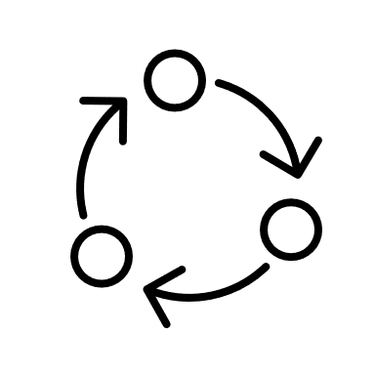






07
Exploring external factors
Could you mention 3 things about people or groups of people related to your performance context that you believe to be the most relevant (in your case)?
You could mention family, partners, children, friends, teammates, training partners, coaches, mentors, managers, agents, idols, … even people you have lost or no longer see.
Follow us on Twitter @PsychMapping
Find out more about us:
www.psychmapping2.com

Slide 9

08
Exploring external factors
Could you mention 3 things about your training/ daily activities and competitions/ special event which you think are the most relevant (in your case)?
My sport/ daily tasks are special because…
Training/ every day work is typically…
Some exercises/ tasks…
Competitions/ presentations/ exams are…
Something important that happened is…
Follow us on Twitter @PsychMapping
Find out more about us:
www.psychmapping2.com

Slide 10





















09
Exploring external factors
Could you mention 3 things about other activities or commitments outside your main performance task which you think are the most relevant (in your case)?
You could mention other hobbies, school or university, family activities, work commitments, travel, religious or cultural activities, participating in social media, playing video or computer games, meeting friends ...
Follow us on Twitter @PsychMapping
Find out more about us:
www.psychmapping2.com

Slide 11

10
Exploring external factors
Are there any other aspects of your performance context that you believe to be relevant (in your case)?
What else?
Mention any other external factors that you think we need know to understand your case.
Follow us on Twitter @PsychMapping
Find out more about us:
www.psychmapping2.com

Slide 12









11
Personal descriptors
Could you mention 3 things that describe you physically (your body) that you believe to be the most relevant (in your case)?
Health, injuries, recovery, pain, fatigue, appearance, height, weight, fitness, strength, speed, agility, flexibility, age, gender…
Follow us on Twitter @PsychMapping
Find out more about us:
www.psychmapping2.com

Slide 13

12
Personal descriptors
Could you mention 3 things about yourself (who you are) that you believe to be the most relevant (in your case)?
I am very/ often/ never/…
I would describe myself as…
Those who know me well say that I am…
I typically do/ think/ value/ want…
Follow us on Twitter @PsychMapping
Find out more about us:
www.psychmapping2.com

Slide 14
















13
Personal descriptors
Could you mention 3 things in yourself that are typical in better or worse moments related to your performance and that you believe to be the most relevant (in your case)?
When I perform good/ bad, I am usually…
I usually feel better/ worse when I …
If I am/ think/ do…, then I usually do better/worse.
Follow us on Twitter @PsychMapping
Find out more about us:
www.psychmapping2.com

Slide 15

14
Personal descriptors
Could you mention 3 aspects that differentiate you from others in your performance context that you believe to be the most relevant (in your case)?
Compared to other people, I am more/less…
One thing that makes me special is…
My case is different because I …
Follow us on Twitter @PsychMapping
Find out more about us:
www.psychmapping2.com

Slide 16

15
Personal descriptors
Are there any other aspects about yourself that you believe to be relevant (in your case)?
Anything
else?
Mention other aspects that characterises you or that describes you in important or frequent moments of your performance and that you think we need to know to understand your case.
Follow us on Twitter @PsychMapping
Find out more about us:
www.psychmapping2.com

Slide 17






16
Psychological skills
Could you mention 3 mental skills that you believe are your psychological strengths and that you believe to be the most relevant (in your case)?
I am good at …
Most of the time I can …
I manage to …
I can avoid …
You could mention your ability to control aspects in your daily life, your emotions, your goals and motivation, your thoughts, beliefs and attitudes, your self-image, your behaviour, your social interactions…
Follow us on Twitter @PsychMapping
Find out more about us:
www.psychmapping2.com

Slide 18






17
Psychological skills
Could you mention 3 mental skills that you feel you need to improve and that you believe to be the most relevant (in your case)?
I feel it’s hard to…
Most of the time, I find it difficult to…
I don’t try to…
A weakness I feel I have is…
You could mention difficulties to control aspects in your daily life, your emotions, your goals and motivation, your thoughts, beliefs and attitudes, your self-image, your behaviour, your social interactions…
Follow us on Twitter @PsychMapping
Find out more about us:
www.psychmapping2.com

Slide 19



18
Psychological skills
Could you mention 3 bad strategies that you use in challenging situations that you know are wrong and that you later regret and that you believe to be the most relevant (in your case)?
To make myself feel better, I ...
When I don’t want to do what I should do, I …
After I fail doing what I planned to do, I ...
Instead of doing what I should , I…
Examples include stress eating, drinking or gambling, procrastinating, making excuses, blaming others, exaggerating problems, avoiding conflicts, abandoning to prevent failure, pretending to not care, intimidating others, faking injuries, cheating…
Follow us on Twitter @PsychMapping
Find out more about us:
www.psychmapping2.com

Slide 20



19
Finishing the map
1) Revise the map. Are there any key concepts that we have not discussed, or which are not noted down and that you belief to be relevant in your case?
2) Please rate each of the key concepts with regards to your case.
Very helpful
Rather helpful than problematic
Equally helpful as problematic
Rather problematic than helpful
Very problematic
Highlight importance
3) Is there are any last aspects about the summary you would like to discuss before you finish the session?
Follow us on Twitter @PsychMapping
Find out more about us:
www.psychmapping2.com

Slide 21
20
Finishing the map
Potential follow-up activities
Go back to the map, with all the entries in colour and some highlighted, and formulate comments and questions that you want to ask?
Choose from the map what, in your opinion, needs to be dealt with most urgently in this service.
If applicable, compare this new map to previous maps and comment on some of the changes.
Highlight which external variables in the map are controllable.
Relate different entries on the map, in particular entries from different columns, to one another.
Follow us on Twitter @PsychMapping
Find out more about us:
www.psychmapping2.com

